Slide 1
2026 Clean elections Workshop

Slide 2
Workshop Overview
Arizona Citizens Clean Elections Act
Arizona Election Basics
$5 Qualifying Contributions
Clean Elections Funding: Applying and Qualifying
Campaign Finance: Reporting Requirements, Contributions, Expenditures, and Usage of Funds
Voter Education: Candidate Statement Pamphlets, Debates, and Commission Tools

Slide 3
ARIZONA Citizens Clean Elections Act

Slide 4
What is the Citizens Clean Elections Act?
In 1998, the people of Arizona passed the Citizens Clean Elections Act.
The Act promotes participation in democracy and fights corruption in politics.
The Act established a campaign finance system which includes:
Voter education,
Campaign finance enforcement, and
Distribution of Clean Elections funding.
Clean Elections’ Purpose
To restore citizen participation and confidence in our political system, improve the integrity of Arizona State government and promote freedom of speech under the U.S. and Arizona Constitutions.

Slide 5
Where does Clean Elections Funding come from?
The Clean Elections Commission does not receive appropriations from the legislature.
No tax dollars from the general fund.
The Clean Elections Commission and candidate funding is NOT taxpayer monies.
Independent funding created by voters.
$5 contributions, collected by Participating Candidates in order to qualify for funding.
A 10% surcharge assessed on civil penalties and criminal fines throughout the state.
Commission penalties assessed through enforcement actions.
Small voluntary donations (rare).

Slide 6
ARIZONA ELECTIONS The Basics

Slide 7
Recognized Parties and Independents
Currently recognized in Arizona:
Democratic
Libertarian
Republican
No Labels
Possible Green Party
Parties must qualify for ballot recognition via petition.
Maintaining recognition is dependent upon the number of registered voters or the number of votes cast at the last general election for the office of governor.
Independent - Any registered voter that is not a member of a recognized party.
Independent candidates may qualify for the General Election ballot under a §16-341 designation.
Independent candidates do not appear on the Primary Election ballot.

Slide 8
Statement of Organization and Statement of Interest
Candidates are required to register as a committee by filing a Statement of Organization with the Secretary of State’s Office
Filed electronically via the campaign finance reporting system.
Must file within 10 days of receiving contributions or made expenditures of $1,300 - in any combination.
The Commission recommends individuals considering participation in the clean elections program file a Statement of Organization before making any expenditures or accepting any contributions.
Potential candidates are also required to file a Statement of Interest with the Secretary of State’s Office.

Slide 9
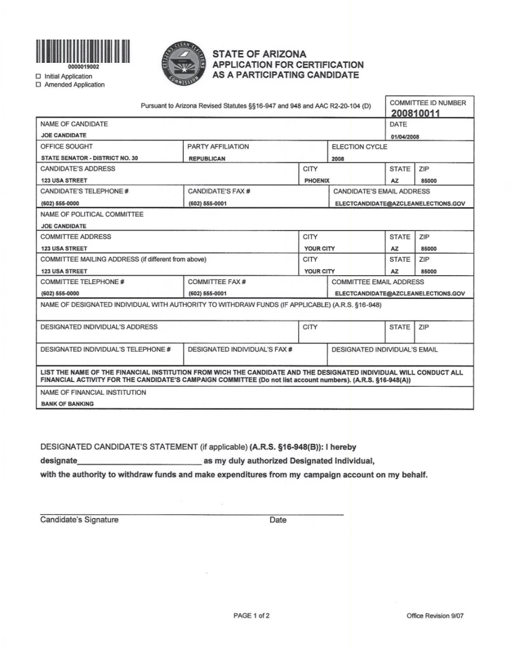
Becoming a Participating Candidate
File Application for Certification as a Participating Candidate:
Filed with Secretary of State’s Office.
Reviewed by Commission Staff.
Deadline is July 28, 2026
If Statement of Organization is filed the same day as Application for Certification, no campaign finance report is necessary.
If filed separately, a campaign finance report detailing all financial activity is required.
Candidates are notified within 7 calendar days if they are certified.

Slide 10
Required Candidate Filings for Running for Office
Any person desiring to become a statewide or legislative candidate and to have the person’s name printed on the official ballot shall file with the Secretary of State’s Office:
Nomination Petitions
Nomination Paper
Financial Disclosure Statement
Filed electronically by e-mail to financial.disclosure@azsos.gov
No longer needs to be notarized.
Candidate Filing Period: March 7, 2026 through April 6, 2026 at 5:00 p.m.

Slide 11
Write-In Candidates
A write-in candidate must file all the documents that are required for other candidates (except nomination petitions), not later than 40 days prior to the Primary or General Election.
Last Day to File as a Write-In Candidate Primary Election: June 25, 2026, at 5:00 p.m.
Last Day to File as a Write-In Candidate General Election: Sept. 24, 2026, at 5:00 p.m.
Only candidates who file complete, timely documents will:
Be considered “official write-in candidates,”
Have their names posted in the polling places and their votes counted,
Not be listed on the ballot or on an insert in an early ballot envelope.

Slide 12
$5 Qualifying Contributions

Slide 13
Qualifying Period August 1, 2025 – July 28, 2026
During the qualifying period candidates can:
Collect $5 qualifying contributions
Submit $5 qualifying contributions to the Secretary of State’s Office to receive Clean Elections funding
Raise and Spend Limited Contributions:
Early Individual Contributions
Personal & Family Contributions
Ends one week before the 2026 Primary Election.

Slide 14
Qualifying Contributions Required
 | Governor | Secretary of State | Attorney General | Treasurer | Supt. of Public Instruction | Corporation Commission | Mine Inspector | Legislature
Minimum | 4000 | 2500 | 2500 | 1500 | 1500 | 1,500 | 500 | 200
Recommend20% More** | 4800 | 3000 | 3000 | 1800 | 1800 | 1,800 | 600 | 240
**Commission recommends collecting at least 20% more than required.
The last day to collect contributions
July 28, 2026
The last day to submit contributions:
August 4, 2026 at 5:00 p.m.

Slide 15
$5 Qualifying Contributions
$5 exactly, cash or check made payable to the candidate’s campaign committee;
Contributors:
Registered voters in the district;
May register person to vote, collect same day;
From any party affiliation;
Nothing of value can be exchanged for a contribution;
Married couples:
May give $10;
Both must sign check;
Submit separate forms;
Solicited or Unsolicited:
Solicitor must be eligible to register to vote;
Cannot be compensated to collect $5.

Slide 16
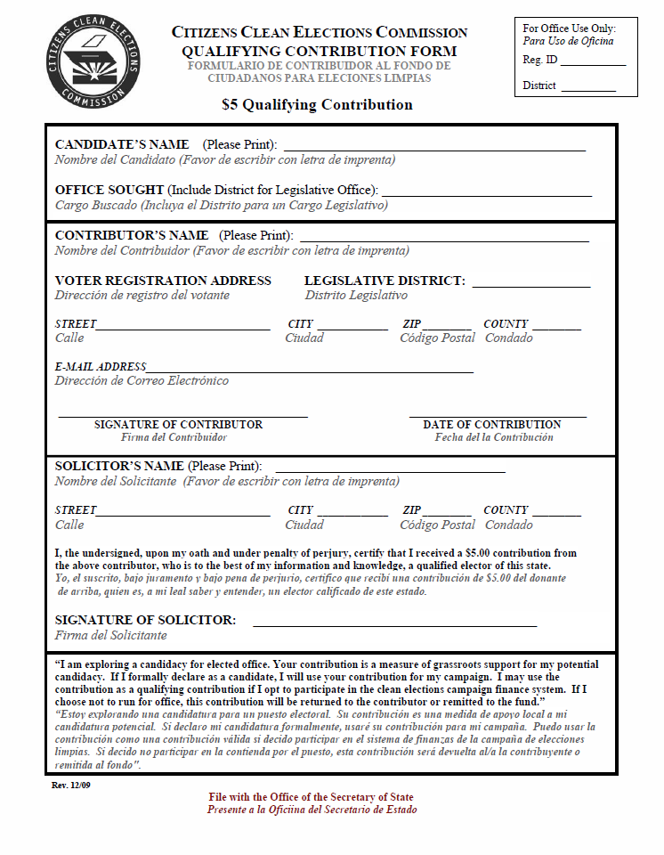
$5 Qualifying Contribution Forms
The Commission provides qualifying contribution forms to candidates free of charge
Up to the recommended 20%
Candidates may develop their own form, but it must be submitted for Commission approval prior to use.
Forms shall include:
printed name,
registration address,
signature of the contributor,
contribution date, and
solicitor information, if no solicitor then the candidate completes the section.
Original – for submission with the application for funding,
1 copy for the candidate’s records, and,
1 copy given to the contributor.

Slide 17
$5 Qual. Contributions & E-Qual
Optional method of collecting petition signatures and $5 Qualifying Contributions.
Accessible through the Secretary of State’s candidate portal.
A candidate may collect all of their $5 qualifying contributions through E-Qual.
Candidates will need to set up an electronic payment account.
Candidates should refer to the E-Qual User Manual when establishing the campaign’s payment account, available at azsos.gov.

Slide 18
CLEAN ELECTIONS FUNDING Applying And Qualifying

Slide 19
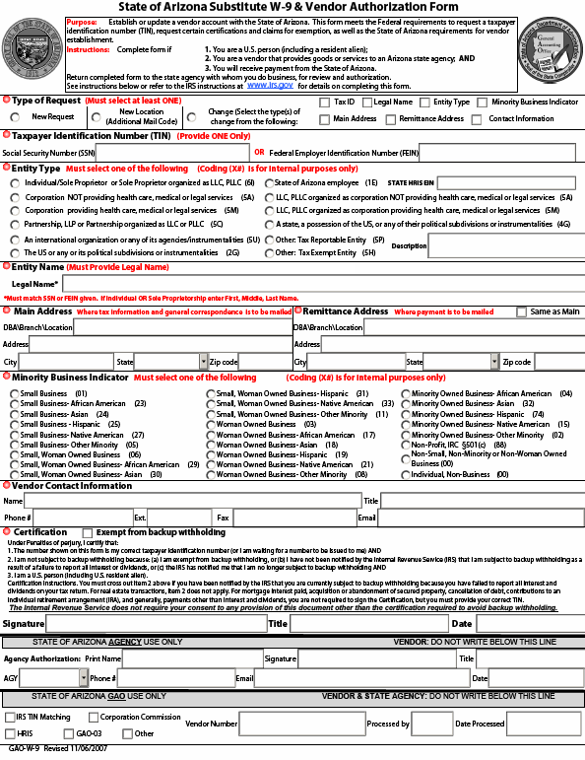
W-9 Vendor Application Form
Fill out an Arizona W-9 Form and return form to the Commission office.
Form available online: GAO-W-9 State of Arizona Substitute W-9.pdf (az.gov)This form designates the candidate as a vendor and allows the Commission to process a check once the candidate is approved for funding.

Slide 20
ACH Form – Direct Deposit
Fill out this form and return it to the Commission. This allows Commission staff the ability to track it and ensure it is processed in a timely manner.
Hard copy checks are no longer used.

Slide 21
Prior to Applying for Funding
Collect at least 20% more qualifying forms than required
Verify the $5 qualifying forms before submitting them
The County Recorders offer access to the Voter Registration Database for verification
Verify the forms are:
Signed
Dated
Person is registered to vote in the district
Remember the Deadline! Don’t Procrastinate!
Last day to submit contributions to Secretary of State’s Office August 4, 2026 at 5:00 p.m.

Slide 22
Contents of Filing for Funding
Application to Receive Participating Funds including:
The $5 Qualifying Contribution List.
E-Qual Report if $5 Qualifying Contributions were collected through E-Qual system.
All original $5 qualifying contribution forms sorted by county.
A check made payable to “Clean Elections Fund” from your campaign bank account for the total amount of $5 qualifying contributions submitted.
Contact the Secretary of State’s Office ahead to make an appointment for filing your application package.
Candidates can apply for funding starting January 2, 2026 if they also submit their nomination papers and petitions at the same time.

Slide 23
$5 Qualifying Contribution Verification Process
Secretary of State will forward your $5 qualifying forms to the County Recorder for verification
The County Recorder has 10 days to verify your forms.
County Recorders will reject the qualifying form if:
Unsigned
Undated
Signature doesn’t match voter registration signature
Person is not registered to vote in the district
Original reporting slip does not accompany contribution

Slide 24
Random Sample Procedure
A 5% or 20% random sample is selected by the Secretary of State’s office.
Sent to the County Recorder(s) office for verification.
Sample accuracy is 110% or greater:
Funding Granted!
Sample accuracy less than 110%:
All qualifying contributions must be verified!

Slide 25
20% Random Sample Procedure Example
Legislative Candidate Assumption:
A candidate for a legislative seat submits 240 qualifying contributions.
Secretary of State takes 20% sample of 240, which is 48.
If 48 of the 48 are valid, 48 x 5 is 240, 240/200 is 120% which is above 110%. Therefore, funding is granted.
If 43 of the 48 are valid, 43 x 5 is 215, 215/200 is 108% which is below 110%. Therefore, all 240 $5 qualifying contribution forms must be verified by the county recorder.
Random Sample Procedure Example is found in the Clean Elections Guide.

Slide 26
Supplemental Submission
If there is an insufficient number of valid forms after the County Recorder checks all of the submitted forms, the candidate may make one supplemental filing to the Secretary of State’s office only if:
The candidate files at least the minimum number of additional forms needed to qualify for funding;
The additional forms are not duplicates from individuals who have previously contributed to that candidate; and
Deadlines for collecting and submitting $5 qualifying contributions have not passed.
The candidate will be denied funding if, following the supplemental filing, the County Recorder determines that the candidate has failed to submit the required number of valid qualifying contributions.

Slide 27
Receiving Funds
The Secretary of State’s office will notify the Commission once the candidate has qualified for funding.
Once notified, the Commission will inform the Department of Administration (DOA) to process the funding as well as inform the candidate that they have been funded. The funding is directly deposited in to the candidate’s campaign bank account typically 1-4 business day after DOA is notified depending on the candidate’s bank.
All candidate funding is awarded electronically via direct deposit. To allow for a timely deposit, candidates should review their W-9 to ensure all information is accurate. Any errors will lead to a delay in funding.

Slide 28
Clean Elections Funding Amounts
Election Funding | Governor | Secretary of State | Attorney General | Treasurer | Supt. Of Public Inst. | Corporation Commission | Mine Inspector | Legislature
Primary | $1,141,328 | $295,743 | $295,743 | $147,836 | $147,836 | $147,836 | $73,943 | $23,099
General | $1,711,992 | $443,615 | $443,615 | $221,754 | $221,754 | $221,754 | $110,915 | $34,649
Independent | $1,997,324 | $517,550 | $517,550 | $258,713 | $258,713 | $258,713 | $129,400 | $40,423
Independent candidates:
Receive one (1) disbursement of 70% of the combined primary and general election funds.
One Party Dominate Legislative Candidates:
Legislative candidates who are in a one-party dominant district may choose to receive the general funding amount in the primary election if they are a member of the dominant party and in a contested primary.
Candidates who make this choice will receive an amount equal to the primary election funding amount in the general election.

Slide 29
CAMPAIGN FINANCE Reporting Requirements, Contributions, Expenditures, and Usage of Funds

Slide 30
Campaign Finance Disclosure
Candidates must file campaign finance reports electronically with the Secretary of State’s office.
Accessed through the Secretary of State’s website at www.azsos.gov
Each report must include all contributions, expenditures, outstanding debt, and financial activity for the reporting period.
Participating candidates are required to file additional campaign finance reports.
Reports are reviewed by the Commission staff.
Failure to file will result in daily fines of $220 for legislative candidates and $600 for statewide candidates, and will delay funding. Additionally, candidates may be required to repay all of their Clean Election funds.

Slide 31
Campaign Contributions A.R.S. §16-901(11)
“Contribution” means any gift, subscription, loan, advance or deposit of money or anything of value made for the purpose of influencing an election. This includes:
A contribution that is made to retire campaign debt from a previous election cycle.
Money or fair market value of anything that is directly or indirectly provided to an elected official for the specific purpose of defraying the expense of communications with constituents.
The full purchase price of any item from a committee.
A loan that is made to a committee for the purpose of influencing an election, to the extent the loan remains outstanding

Slide 32
Early Individual Contributions
Candidate Type | Early Contribution Limit
Legislature | $5,775
Mine Inspector | $18,486
Corporation Commission | $36,959
Supt. Of Public Inst. | $36,959
Treasurer | $36,959
Attorney General | $73,936
Secretary of State | $73,936
Governor | $76,880
Contributions collected during the Qualifying Period only
$220 per individual - monetary, in-kind contribution or loan
Received from individuals only
Does not have to be resident of Arizona
Does not have to be registered to vote
Legal residents of the United States only
May not be received from PACs, corporations, businesses, unions, LLC, etc.
Must be received and spent by July 28, 2026
Any remaining early contributions must be sent to the Commission.

Slide 33
Personal & Family Early Contributions
Candidates may spend a limited amount of their own monies or family monies on their campaign.
Statewide: $1,910
Legislature: $970
Personal and family contributions are in addition to early individual contributions.
Personal contributions must be spent by July 28, 2026.
Any unspent personal contributions must be returned to the contributor.
“Family member” means parent, grandparent, aunt, uncle, child or sibling of the candidate or the candidate’s spouse, including the spouse of any of the listed family members, regardless of whether the relation is established by marriage or adoption.

Slide 34
Other Early Contribution Types
Loans
A loan is considered to be a contribution.
Candidate may designate his personal contribution as a loan.
Other individuals may loan money to the campaign.
Loans apply towards early contribution limits.
Loans must be repaid promptly upon receiving Clean Elections funding (within 7 days).
In-Kind Contributions
An in-kind contribution is a contribution of goods or services or anything of value.
In-kind contributions apply towards early contribution limits.

Slide 35
Disclosure Requirements for Contributions
A campaign finance report must include all contributions accepted by the committee through the end of the reporting period.
Each contribution shall include the name, address, occupation and employer of the contributor.
Contributions of $100 or less may be aggregated.

Slide 36
Contributions Exceptions A.R.S. §16-911
Campaign Volunteers - A volunteer’s services or expenses that are incurred through volunteering are not considered campaign contributions. Volunteer services are unlimited and do not need to be reported such as:
Travel expenses
Use of real or personal property
Cost of invitations, food or beverages - event expenses
Internet activity such as the use of unpaid e-mail and social media
Political Party Exception - A payment by a political party to support its nominee is not a contribution (e.g. printing or distribution of voter guides, sample ballots, pins, bumper stickers, handbills, brochures, posters, yard signs and other similar materials distributed through the party). This also includes expenditures that are coordinated with the party’s nominee.
Legal and Accounting Services - The payment of a committee’s legal or accounting expenses by any person is not considered a campaign contribution.

Slide 37
Campaign Expenditures A.R.S. §16-901(25)
Expenditures
An “expenditure” means any purchase, payment or thing of value that is made by a person for the purpose of influencing an election.
All expenditures made by the campaign committee must be reported in the period in which they are incurred.
Participating candidates may only use campaign funds to pay for goods and services for direct campaign purposes.

Slide 38
Campaign Expenditures Cont.
Joint Expenditures
A joint expenditure is made when two or more candidates agree to share the cost of goods or services.
Reimbursements
A candidate may authorize an individual to make campaign expenditures as long as the campaign has sufficient funds to make the purchase. The date of the expenditure is when the purchase is made by the agent.
If the agent uses their personal monies, a reimbursement from the campaign must be made within 7 calendar days.
The expenditure must be reported as an itemized expenditure.
Expenditures for campaign consulting or advising must have a detailed description of the service provided in campaign finance reports

Slide 39
Campaign Expenditures & Consultants
A “Campaign Consultant” is any person paid by a participating candidate’s campaign or who provides services that are ordinarily charged to a person, except for services provided for in ARS §16-911(6)(b).
Participating candidates may only make an advance payment for services if an itemized invoice is received at the time of the advanced payment.
If an invoice is not provided it will be deemed to not be a direct campaign expenditure.
Advance payments for postage or advertising may be advanced if a written estimate is provided and the balance returned to the candidate.
The Commission shall be included on the mail batch for all mailers and invitations.
Failure to provide this information within 7 days after the mailer has been mailed may be considered as evidence the mailer was not for a direct campaign purpose.
R2-20-703.01

Slide 40
Campaign Expenditures & Political Parties
With the passage of Proposition 306 in 2018, participating candidates are prohibited from transferring money to political parties and/or 501(a) entities.

Slide 41
Use of Prior Assets
A participating candidate may use assets from a prior election cycle.
The candidate must purchase the assets from the previous campaign committee.
If the candidate was a participating candidate during the prior election cycle, the payment for the asset must be made to the Commission.
The purchase must be made for an amount equal to at least 1/5 (or 20%) of the original purchase price.
Prior assets may not be utilized until payment has been made.

Slide 42
Fixed Assets
A fixed asset is an item that has a value and function beyond the campaign (i.e. tablets, computers, cell phones, printers).
Candidates that purchase a fixed asset that exceeds $200 (including tax) have two options:
Pay the Commission 80% of the original purchase price (including the tax) and keep the item.
Give the item to the Commission.
Purchase of fixed assets, or return of fixed assets, must occur within 14 days after the primary election, or general election if the candidate was successful in the primary.

Slide 43
Travel Expenses
Travel expenses that are directly related to the campaign may be paid for with campaign funds and if so, must be reported.
Volunteers can be reimbursed for travel expenses (up to 62.5¢ per mile).
Candidates may only make direct fuel purchases for their personal vehicles.
If a candidate makes direct fuel purchases (candidate only) or reimbursements for mileage (candidate or volunteers), a travel log of the trip must be kept and include: date, miles traveled, and potential reimbursement rate (up to 62.5¢ per mile).
Bus tickets, plane tickets, rental cars, etc. purchased on behalf of the campaign must be paid for with campaign funds and must be reported.

Slide 44
Food Expenses
Maximum per person of $11 for breakfast, $16 for lunch, $27 for dinner.
All food expenditures paid for with campaign funds must be reported.
Food expenses for candidates are discretionary.
Any expenditure must be directly related to a candidate’s campaign

Slide 45
Petty Cash Expenditures
Cash balance not to exceed $1,910 at any time.
Cash expenditures not to exceed $220.
Keep receipts for actual expenses.
Campaign finance reports must identify the full name and street address of the person providing goods and services for expenditures paid with petty cash.
This includes any payment to a sub-vendor (itemization) made on behalf of the campaign.

Slide 46
Itemized Expenditures
Expenditures must be itemized when:
A candidate has authorized another agent to make campaign purchases and personal monies are used (i.e. reimbursements).
Consultants or vendors use services from other vendors in their fulfillment of the candidate’s campaign expenditure.
A candidate makes a petty cash expenditure.

Slide 47
Campaign Expenditures & Family
A family member hired by the campaign must be identified as “family member” on the campaign finance reports (use the transaction memo line).
A family member’s business hired by the campaign must be identified as “family business” on the campaign finance report (use the transaction memo line).

Slide 48
Additional Expenditure Limitations
Participating candidates may not use campaign funds for the following:
Cost of legal defense
Personal use, which includes:
Household food items
Clothing (Suits, Shoes, Ties, Accessories, etc.)
Tuition payments
Mortgage, loan, rent, lease or utility payments for any part of any personal residence of the candidate or a member of the candidate’s family
Admission to a sporting event, concert, theater, or other form of entertainment
Dues, fees or gratuities at a country club, health club, recreational facility or other nonpolitical organization
Gifts or donations
Fixed assets with a value in excess of $800

Slide 49
Post-Election Return of Monies
Remaining primary monies cannot be transferred forward to the general election period.
All money remaining in your account at the end of the primary election must be returned to the Commission by August 11, 2026.
All money remaining in your account at the end of the general election must be returned to the Commission by November 17, 2026.
You may only retain monies sufficient to pay any outstanding bills. Must be paid within 30 days.
No new bills may be incurred.

Slide 50
Post-Election Return of Monies
All funds need to be returned by a cashier’s check drawn on the candidate’s campaign bank account and MUST be returned no later than 2-weeks after the election.
Any fees for the issuance of the cashier’s check are a direct campaign expenditure and should be reported on campaign finance reports.
Candidates must account for all outstanding transactions in the funds returned to the Commission otherwise they will need to reconcile outstanding expenditures with personal monies.
The Commission will not issue reimbursements to candidates once the funds have been returned.
Participating candidates may not exceed the primary or general election spending limits.
The Commission may waive the return of the funds if:
The Commission staff determines the amount to be returned to be de minimus;
The Commission staff determines the cost of recovery exceeds the amount of the return;
The funds to be returned shall not exceed $25; and
The Commission is notified of any waiver of the return of funds.

Slide 51
Record Keeping
Keep all records for 3 years, including but not limited to:
Bank Statements and Deposit Slips
Receipts/Invoices
Check Register
Travel Log
Contracts from vendors
Bills
Documentation of contributions from individuals
$5 qualifying contribution forms
All participating candidates will be subject to an audit. Audits will begin after either the primary or general election. The audit will include all campaign activity from the start of your campaign until the end.
Commission staff and auditors will request documentation.
The candidate has the burden of proving every expenditure was made on behalf of the campaign

Slide 52
Campaign Finance Activity Key Points
Conduct all campaign finance activity through a single bank account.
Do not exceed contribution and expenditure limits.
Do not use campaign funds for personal use.
Remember participating candidates have the burden of proving that expenditures are for a direct campaign purpose - keep all of your records.
Itemize reimbursements, petty cash expenditures, or any expenditure that utilizes a sub-vendor.
Provide detailed information in the transaction memo line for any consulting services or expenditures made to family members.
Do not “carry over” primary money to the general election.

Slide 53
VOTER EDUCATION Candidate Statement Pamphlet & Debates

Slide 54
Voter Education-Debates
Participating candidates are required to attend a Commission sponsored debate during both the primary and general election periods. Non-participating candidates are invited and encouraged to attend.
Commission staff will notify you of the candidate debate dates.
Failure to attend a debate may result in an enforcement action.
Voters will be notified via multiple communication channels of the debate schedule and participants.
Independent and write-in candidates will not be invited to participate in primary-election debates.

Slide 55
Voter Education Candidate Statement Pamphlet
Candidates may submit a statement, bio and photo for inclusion in the pamphlet which will be mailed before early voting in the primary and general elections.
Statements, bios and photos must be submitted online at www.azcleanelections.gov.
Deadlines for Statements*
Primary – Midnight, April 1, 2026
General – Midnight, August 3, 2026
Statements will be available in the printed pamphlet and digitally.
Independent and write-in candidates will not be able to submit statements or bios for the primary election pamphlet.
* dates subject to change

Slide 56
Candidate Compass
Candidate Compass Tool:
Present information in an unbiased way
Let voters filter information according to the issues that matter to them
See where the candidates stand on the issues
Make sure the research tool is easy-to-use and information is presented in an easy-to-understand way
Candidates will be able to submit their answers for Candidate Compass when submitting their statement for the candidate statement pamphlet.

Slide 57
Additional Materials
Citizens Clean Elections Guide
Available on the Commission’s website: www.azcleanelections.gov
$5 Qualifying Contribution Forms
Available from the Commission and can be picked up at:
Citizens Clean Election Commission 1110 W Washington, Suite 250 Phoenix, AZ 85007
Also available to download from the Commission’s website: www.azcleanelections.gov
Available to be mailed to the Candidate – sent via FedEx
Commission Staff
Mike Becker, Policy Director
mike.becker@azcleanelections.gov
Phone: 602-364-3477
Toll free: 1-877-631-8891

Slide 58
PARTICIPATING CANDIDATE WORKSHOP Conclusion

